Slide 1

Partnership & Research Development Fund (PRDF) Grants Round 2026
Call for Applications & Institutional Briefing Webinar
The Australia Africa Universities Network (AAUN) is a group of 29 leading universities in Australia and Africa, connecting academics and early-career researchers through institutional partnerships in order to address research and development challenges facing both continents.
The Network, established in 2012, fosters growing relationships between Australia and Africa by building research and education partnerships between the continents. The AAUN is integral to enabling Australia and Africa to work together creatively, innovatively and in equal partnership.

Slide 2

Australian University Members (11)
Australian National University
Charles Sturt University (*new)
Curtin University (Co-Chair)
Edith Cowan University (*new)
Murdoch University
RMIT University (*new)
University of Newcastle (Deputy Co-Chair)
University of New South Wales
University of Queensland
University of Western Australia
Western Sydney University
African University Members (18)
Amoud University (*new)
Bahir Dar University
Makerere University (Deputy Co-Chair)
Mekelle University (*new)
Namibia University of Science and Technology (*new)
Nelson Mandela University
Tshwane University of Technology
Université Chiekh Anta Diop (*new)
University of Botswana
University of Cape Town
University of Ghana
University of Gondar (*new)
University of Mauritius
University of Mpumalanga (Co-Chair)
University of Nairobi
University of Pretoria
University of Rwanda
Walter Sisulu University (*new)
Annual Membership Fee
Australia: AUD $10,000
Africa (excl. South Africa): AUD $4,000
South Africa: AUD $5,000

Slide 3
What is the AAUN Partnership & Research Development Fund (PRDF)?
The AAUN Partnership & Research Development Fund (PRDF) offers small catalytic grants to foster institutional partnerships in the network and develop research collaborations that address distinct mutual challenges. The PRDF provides one year of catalytic seed funding with the firm expectation that funded projects will be excellent, build specialist teams, achieve outputs and impact, and be sustainable through the identification of additional external funding. There are over 75 PRDF projects currently in progress or completed from earlier rounds.
PRDF awards are a maximum of AUD 10,000 per project in matching funding and must be matched in cash funding by partner teams.
For example, if a project partner team raises AUD 10,000 cash through combined internal funding, then the team can apply for the equivalent amount of AUD 10,000 via the PRDF; if successful, they would then have total project funding of AUD 20,000. If the project team instead raises only AUD 8,000 internally, then they can apply for the equivalent amount of AUD 8,000 in matching funding from the PRDF to have total project funding of AUD 16,000. If a project team raises more than AUD 10,000 in internal funding, they can only apply for a maximum of AUD 10,000 in matching PRDF funding.

Slide 4
Applications must include at least two African AND two Australian AAUN member universities. The collaboration can also include non-AAUN universities and other external partners but must be led by and have an active core of AAUN member universities. It is a priority for AAUN to engage newer members in the PRDF.
PRDF Call and Guidelines for 2026. We are delighted to announce the call for proposals for PRDF 2026 according to these guidelines. The round opens for applications on 1 May 2026 and closes on 30 June 2026 at 23h59 in the local time zone of the project lead institution. Winners will be notified in August 2025, and Awards will be presented at the AAUN Forum in Perth on 1-2 September 2026.
This PRDF round is supported and reviewed equally by both AAUN Australia and AAUN Africa.
We expect to fund 8 projects in 2026: 4 led by African member universities and 4 led by Australian member universities.

Slide 5
Priority Research Themes 2026. We encourage applications from natural and social scientists in the following priority areas:
Environment, climate, and the energy transition
Equality, security, and social cohesion
Public health and human wellbeing
Sustainable food and water systems
Artificial intelligence and the digital revolution.
Each application should also briefly identify the relevance of the project to the following cross-cutting themes/frameworks:
UN Sustainable Development Goals (SDGs)
African Union Agenda 2063
The role of higher education institutions and networks
Diversity, equity, and inclusion (DEI)
Youth, including Early Career Researchers.

Slide 6
Am I eligible to apply?
PRDF applications should be led by academic staff (faculty members) at AAUN member universities.
At least two Awards per round shall be made to projects led by Early Career Researchers (ECRs, who hold a PhD and are up to five years since PhD award date) who hold appointments at AAUN member universities that extend at least through the project timeframe (to end of 2027).
Applications are invited from:
New projects and teams, including those arising from recent AAUN fora and research workshops.
Existing AAUN research teams, where the progress reports show major advance and limited additional funds would strengthen bids for further external grant funding. Only projects that have submitted reports are eligible to apply again.
Collaborative teams led by AAUN members and involving other related networks, such as the African Research Universities Alliance (ARUA), Association of African Universities (AAU), and IORA Indian Ocean University Network (UNIOR).

Slide 7
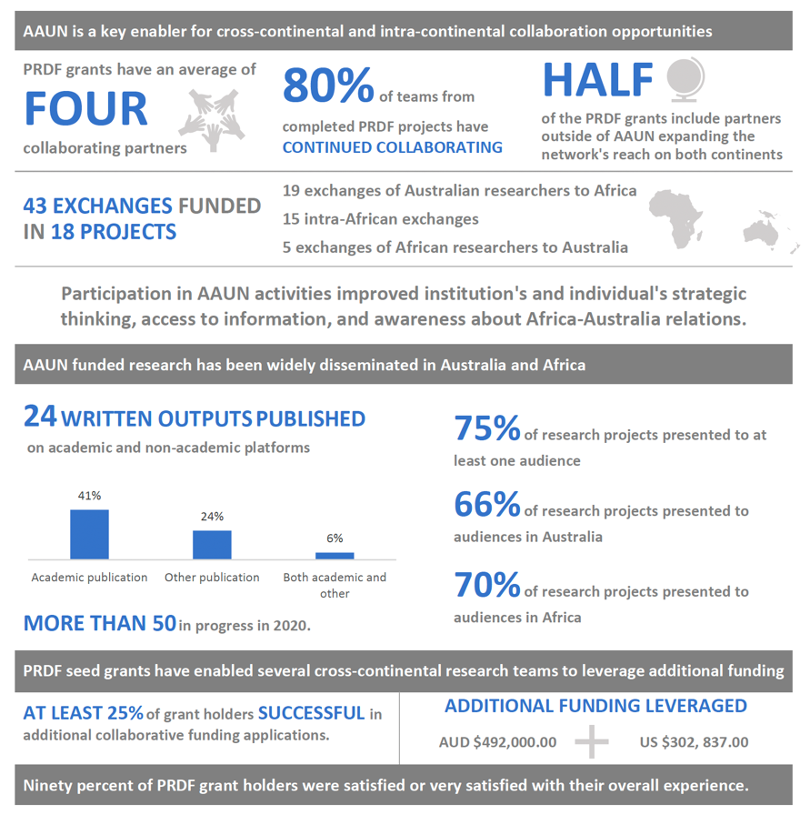
What can PRDF funds be used for?
PRDF funds may cover the costs of exploratory research initiatives, targeted workshops, academic staff exchanges and the formation of collaborative networks, among other activities. Applications that incorporate a research mobility component for early career researchers and postgraduate students are encouraged.
Note: As a small, innovation seed fund, the PRDF does not cover GST, university overheads (such as management, equipment depreciation, etc.), salaries or salary supplementation, scholarships, course fees and bench fees.
Data from AAUN Research Assessment 2021

Slide 8
What are the criteria for assessment?
Applications will be assessed against the following criteria:
Impact – the proposal is of high quality and addresses a distinct research problem for Australia and Africa. The proposal is likely to have significant impact in discovery, application, or policy.
Relevance to AAUN objectives – the proposal aligns with AAUN strategic objectives and addresses a high priority area in the listed areas.
Sustainability – the proposal is likely to build longer term international relationships based on genuine commitment by the research partners - and will provide a plan for attracting continuing external funding.
Teamwork – the proposal involves a team of researchers across relevant disciplines and regions. Proposals that include early career researchers and PhD students are particularly encouraged and an outline of how this integration will be achieved should be provided.
Outcomes – the proposal is likely to result in academic publications/dissemination, external funding, and/or policy outcomes in the medium term.

Slide 9
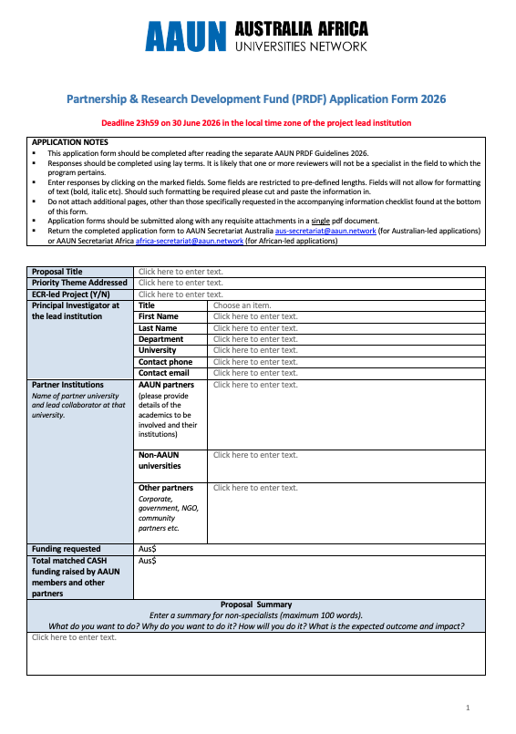
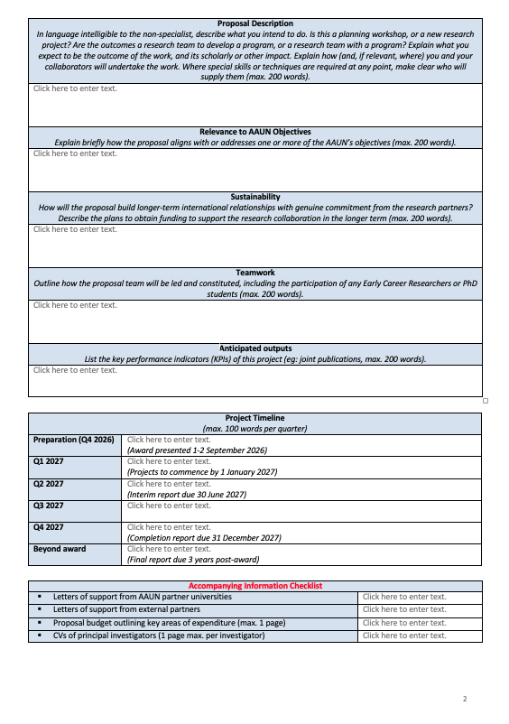
Applications will need to be accompanied by:
Letters of support from AAUN partner universities confirming official institutional support and specifying any cash and/or in-kind contributions (using attached template).
Letters of support from external partners, also identifying cash and/or in-kind contributions.
Proposal budget outlining key areas of expenditure (1 page max.).
CVs of principal investigators (1 page max. each).
PRDF application form

Slide 10
How do I apply?
All applications must first be approved for submission through an internal review at the principal investigator’s university to ensure local strategic alignment and support. A list of key institutional contacts is provided separately. Applicants are required to identify committed cash contributions as well as in-kind support for the project from institutions involved.
Applications along with all accompanying documents should be submitted through the AAUN Secretariat Australia (for applications led by Australian member universities) or AAUN Secretariat Africa (for applications led by African member universities) by 23h59 on 30 June 2026 in the local time zone of the project lead institution. Applications that are incomplete or received after the closing date will not be considered. Applications will be assessed and ranked by a selection committee from Australia and Africa.

Slide 11
PRDF Timelines:
1 May 2026: Applications open
30 June 2026: Applications close
July 2026: Applications assessed
August 2026: All applicants notified of outcomes
1-2 September 2026: Awards presented at AAUN Forum in Perth
September-December 2026: Preliminary organisation of funded projects
1 January 2027: Projects commence
30 June 2027: Interim report due
31 December 2027: Projects finish and completion report due
3 years post-project: Final report due capturing all project outcomes and outputs.

Slide 12
What are the financial and reporting obligations?
Allocated funds will be deposited in local currency via bank transfer to the Principal Investigator’s nominated university account. Awarded funding should be expended within 12 months. Any unspent funds at the conclusion of the 12-month award period will be returned to the AAUN.
Awardees will be required to submit an interim report to AAUN after 6 months and a 1-year completion report at the conclusion of the 12-month award period. A final report will be requested 3 years after the date of the award. This reporting is essential in assisting AAUN to track outcomes, demonstrate productivity and monitor return on investment. The AAUN will send a report template and a reminder by email at these intervals. Awardees who fail to submit satisfactory reports will be ineligible to apply for future AAUN funding.

Slide 13
If successful, how does AAUN expect to be acknowledged?
Please note that it is mandatory to acknowledge AAUN appropriately in publications or conferences in order for us to attract further funding and to present the strengths of the AAUN partnership to government, business, agencies, and universities. Any initiatives funded by the PRDF should adequately credit the AAUN, including the display of the AAUN logo. Any publications resulting from a PRDF-funded project should acknowledge AAUN as a supporter or participant. Principal Investigators are welcome and encouraged to participate in AAUN initiatives and events as they arise, including AAUN forums and workshops.

Slide 14

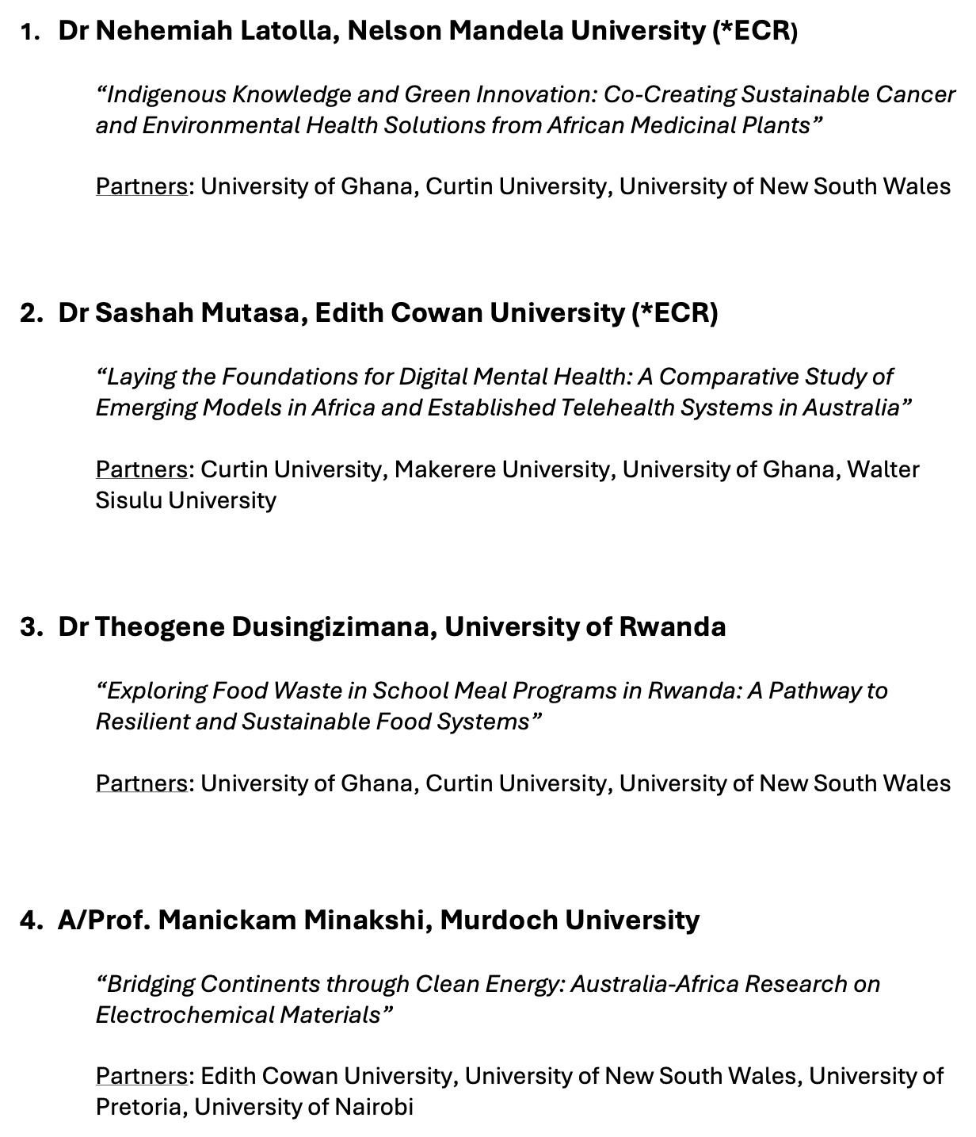
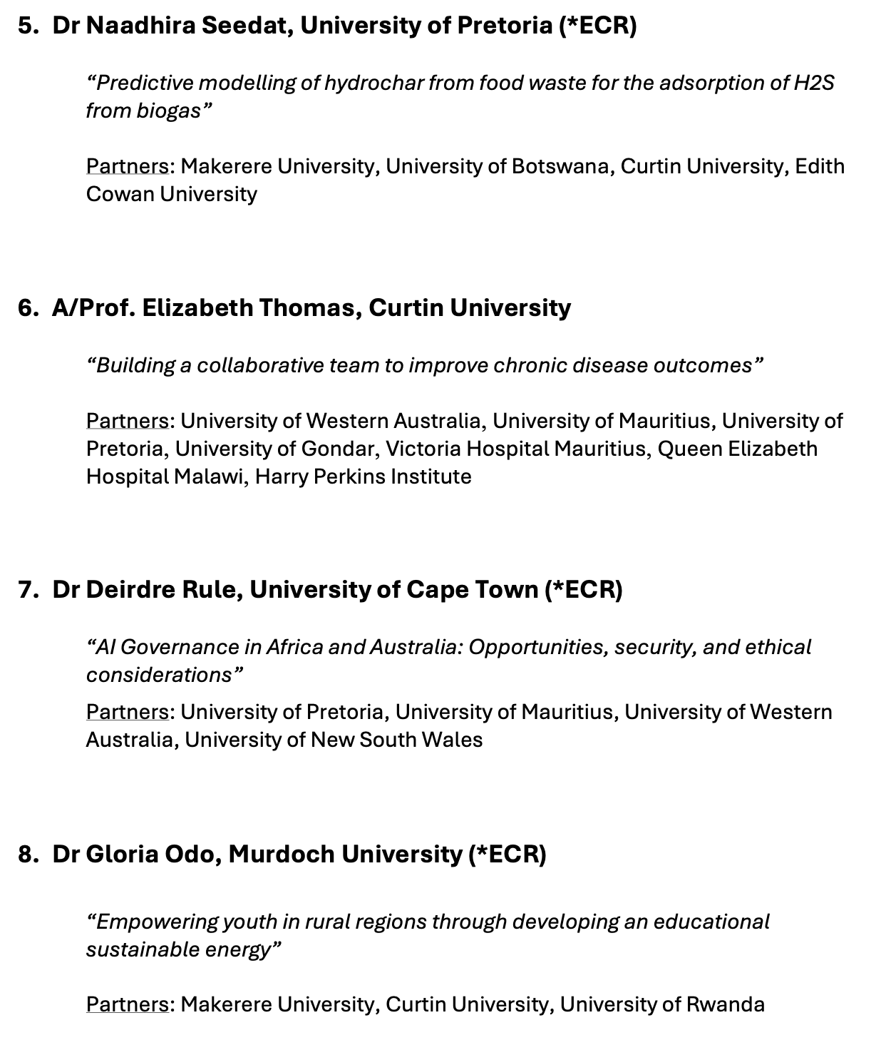
2025 AAUN PRDF Grant Winners

Slide 15



aus-secretariat@aaun.network (Australia) and africa-secretariat@aaun.network (Africa)
http://aaun.edu.au/
https://au.linkedin.com/company/australia-africa-universities-network
Contact information and submission points:
AAUN Australia Secretary: Ruvi Gordema via aus-secretariat@aaun.network
AAUN Africa Secretary: Dr Sussy Munialo via africa-secretariat@aaun.network
For more information and to see previous winners, go the PRDF webpage: https://aaun.edu.au/research-development/

Slide 16
Q&A

